Slide 1
WindowsSever

Slide 2
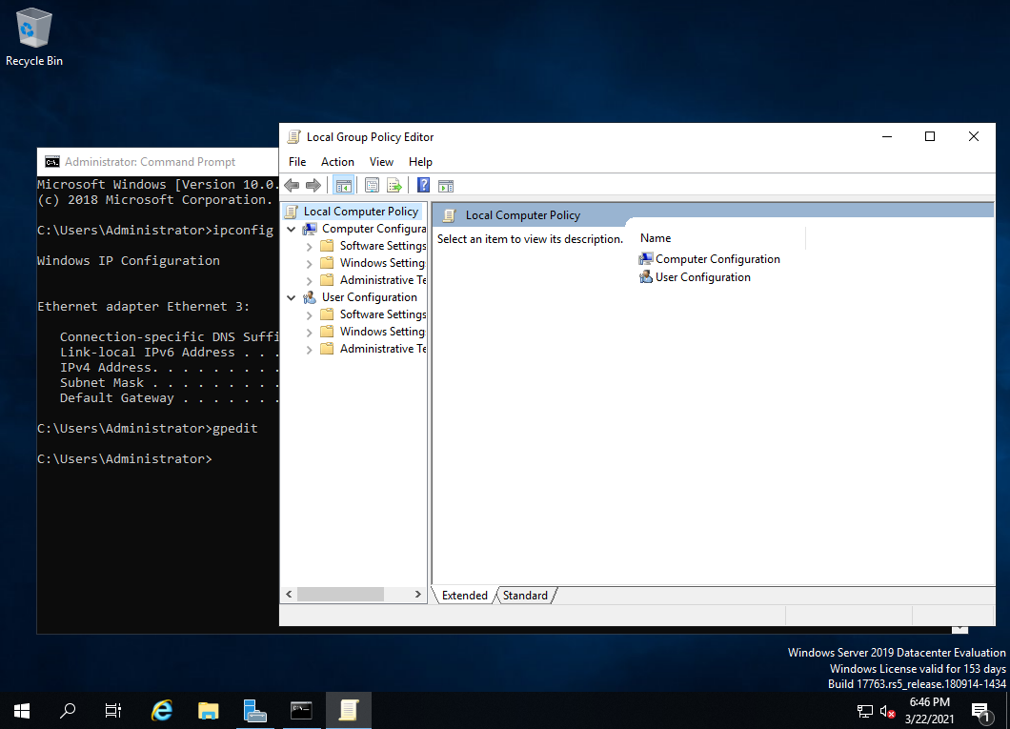
Gpedit(本機群組原則編輯器)

Slide 3
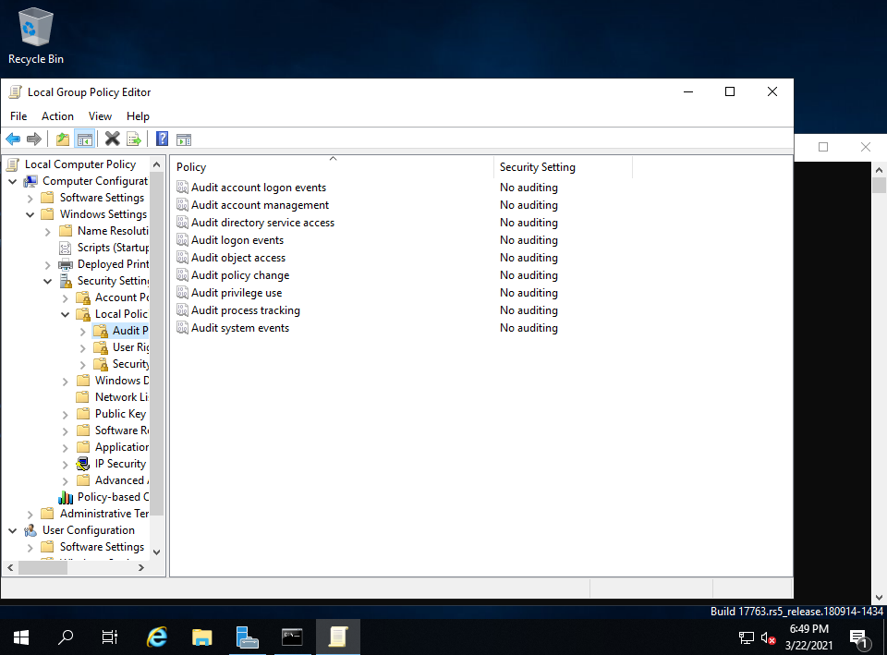
本地端內群組

Slide 4
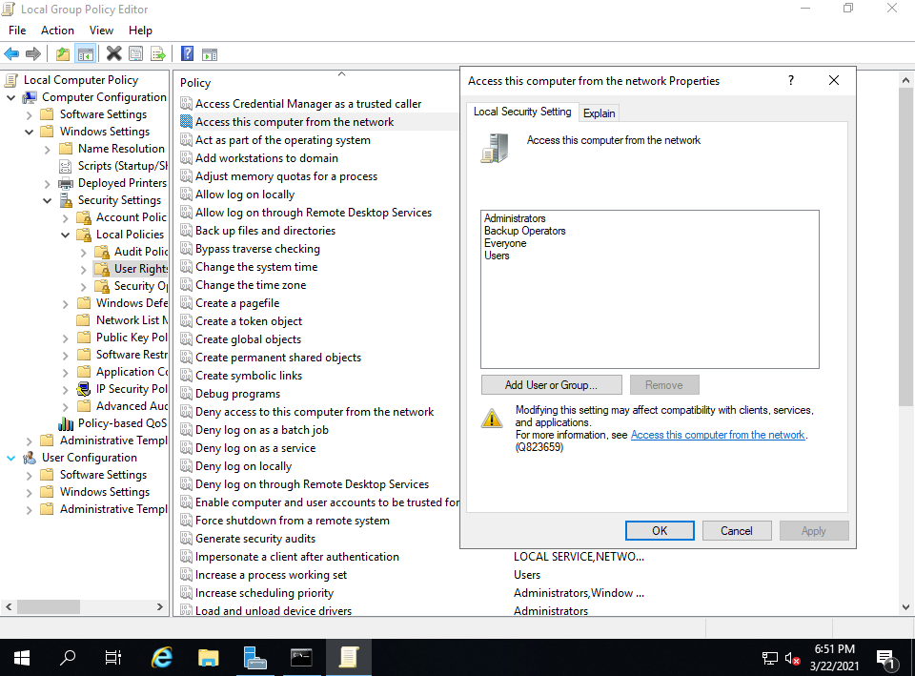
拒絕本機端登入

Slide 5
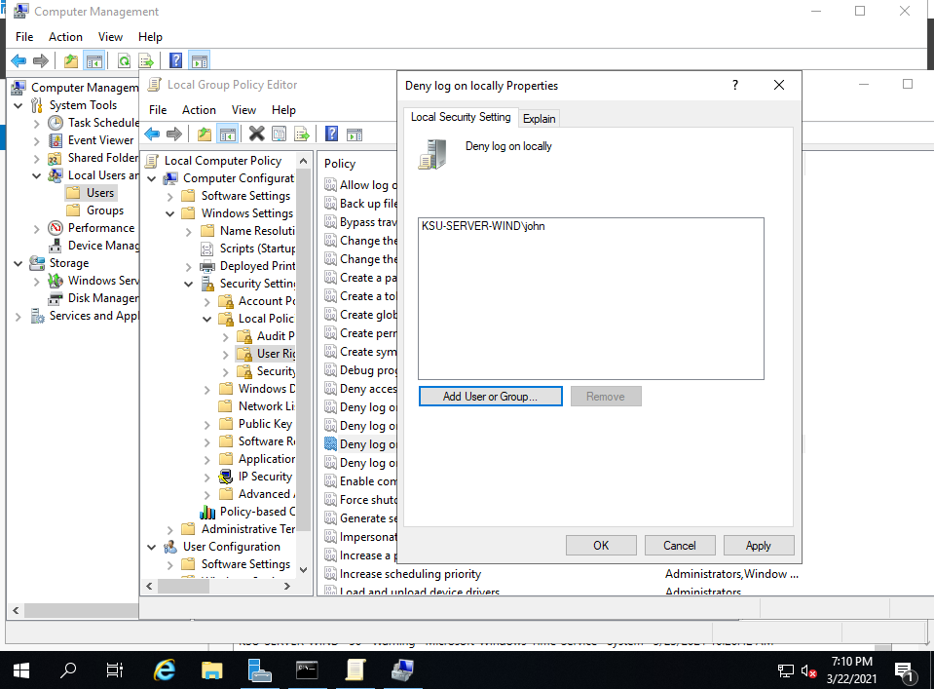

Slide 6
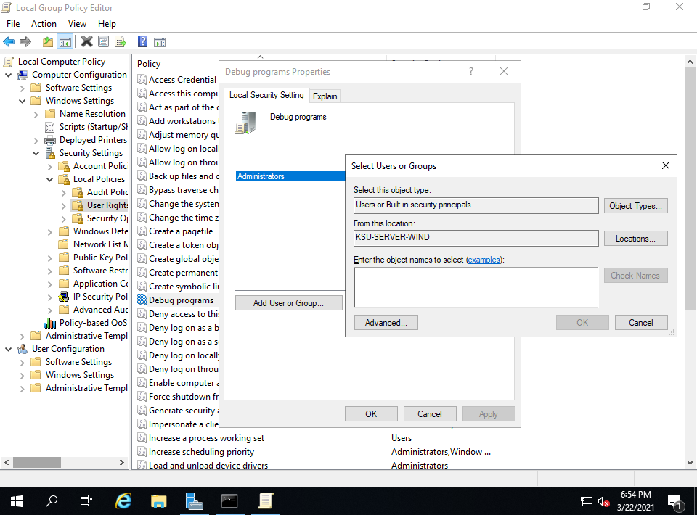
Debug programs(除錯)

Slide 7
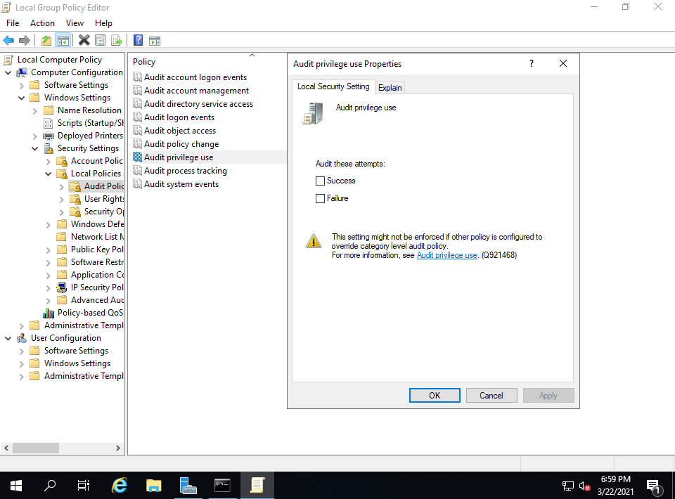
稽核原則

Slide 8
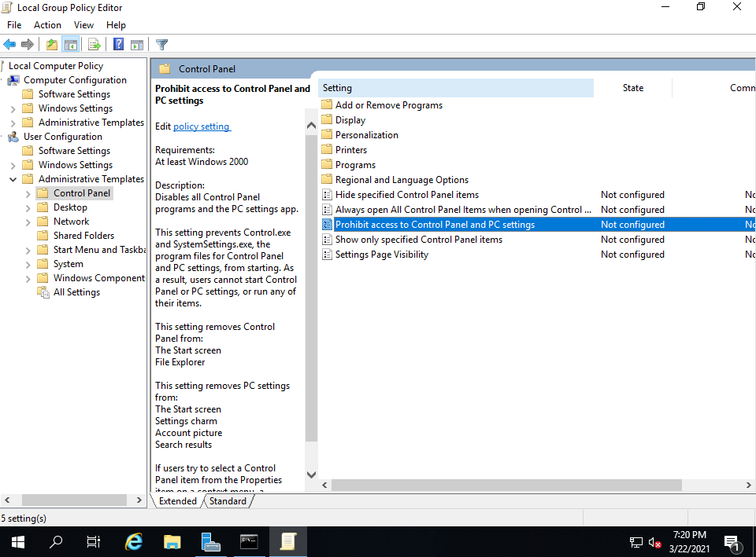
使用者設定

Slide 9
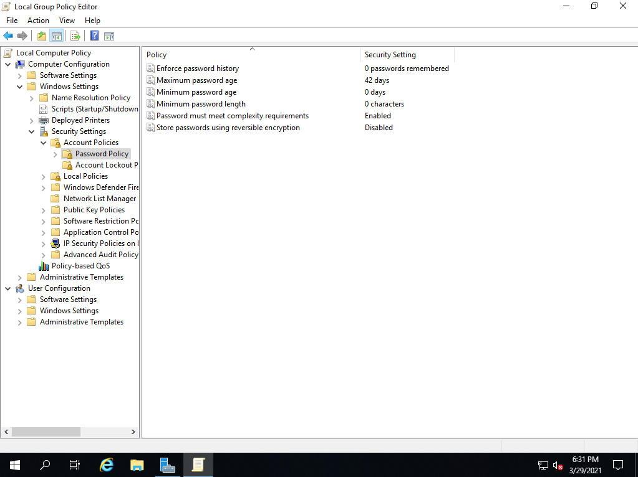
密碼原則

Slide 10
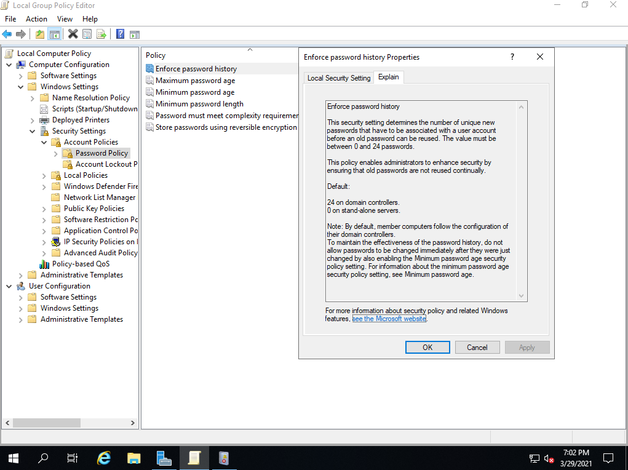
使用可還元的加密來存放密碼

Slide 11
Enforce password history
This security setting determines the number of unique new passwords that have to be associated with a user account before an old password can be reused. The value must be between 0 and 24 passwords.
This policy enables administrators to enhance security by ensuring that old passwords are not reused continually.
Default:
24 on domain controllers.
0 on stand-alone servers.
Note: By default, member computers follow the configuration of their domain controllers.
To maintain the effectiveness of the password history, do not allow passwords to be changed immediately after they were just changed by also enabling the Minimum password age security policy setting. For information about the minimum password age security policy setting, see Minimum password age.

Slide 12
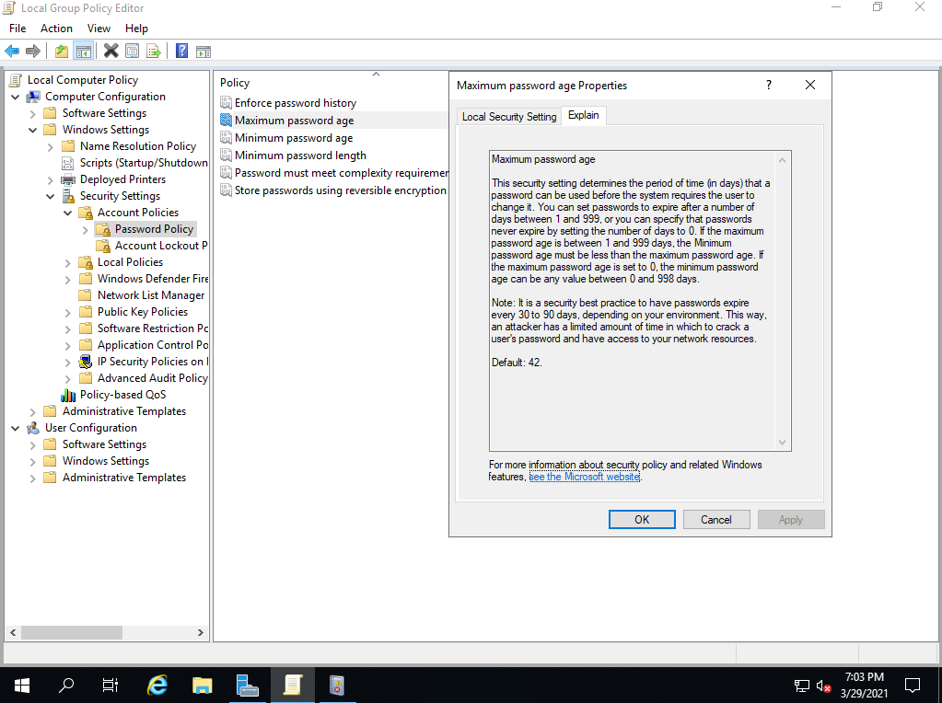
密碼必須符合複雜性需求

Slide 13
Maximum password age
This security setting determines the period of time (in days) that a password can be used before the system requires the user to change it. You can set passwords to expire after a number of days between 1 and 999, or you can specify that passwords never expire by setting the number of days to 0. If the maximum password age is between 1 and 999 days, the Minimum password age must be less than the maximum password age. If the maximum password age is set to 0, the minimum password age can be any value between 0 and 998 days.
Note: It is a security best practice to have passwords expire every 30 to 90 days, depending on your environment. This way, an attacker has a limited amount of time in which to crack a user's password and have access to your network resources.
Default: 42.

Slide 14
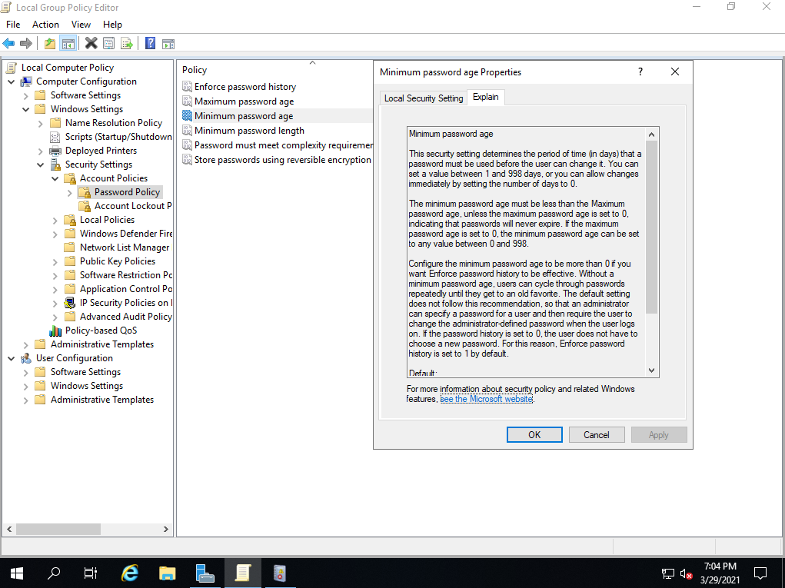
密碼最常使用期限

Slide 15
Minimum password age
This security setting determines the period of time (in days) that a password must be used before the user can change it. You can set a value between 1 and 998 days, or you can allow changes immediately by setting the number of days to 0.
The minimum password age must be less than the Maximum password age, unless the maximum password age is set to 0, indicating that passwords will never expire. If the maximum password age is set to 0, the minimum password age can be set to any value between 0 and 998.
Configure the minimum password age to be more than 0 if you want Enforce password history to be effective. Without a minimum password age, users can cycle through passwords repeatedly until they get to an old favorite. The default setting does not follow this recommendation, so that an administrator can specify a password for a user and then require the user to change the administrator-defined password when the user logs on. If the password history is set to 0, the user does not have to choose a new password. For this reason, Enforce password history is set to 1 by default.
Default:
1 on domain controllers.
0 on stand-alone servers.
Note: By default, member computers follow the configuration of their domain controllers.

Slide 16
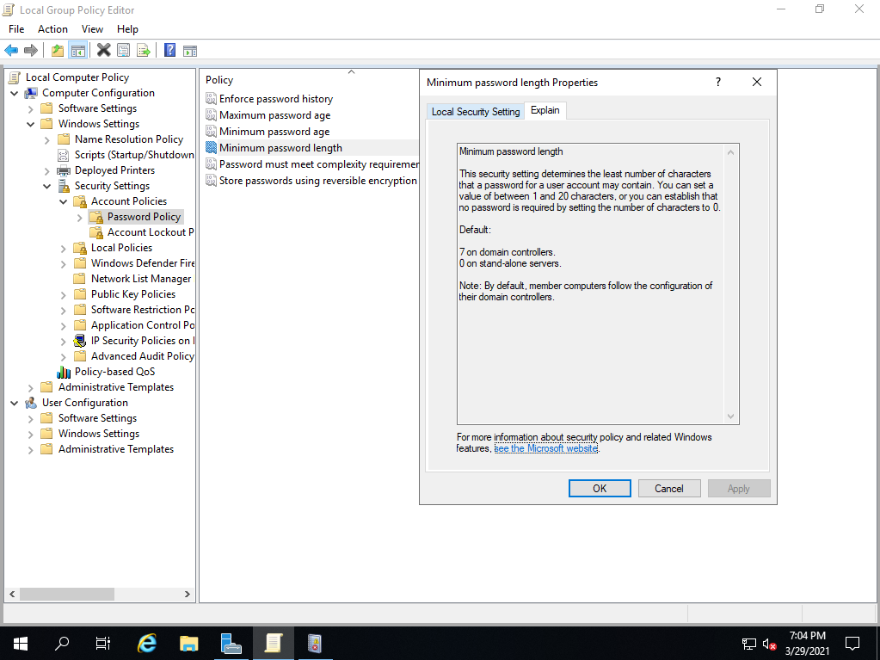
密碼最短使用期限

Slide 17
Minimum password length
This security setting determines the least number of characters that a password for a user account may contain. You can set a value of between 1 and 20 characters, or you can establish that no password is required by setting the number of characters to 0.
Default:
7 on domain controllers.
0 on stand-alone servers.
Note: By default, member computers follow the configuration of their domain controllers.

Slide 18
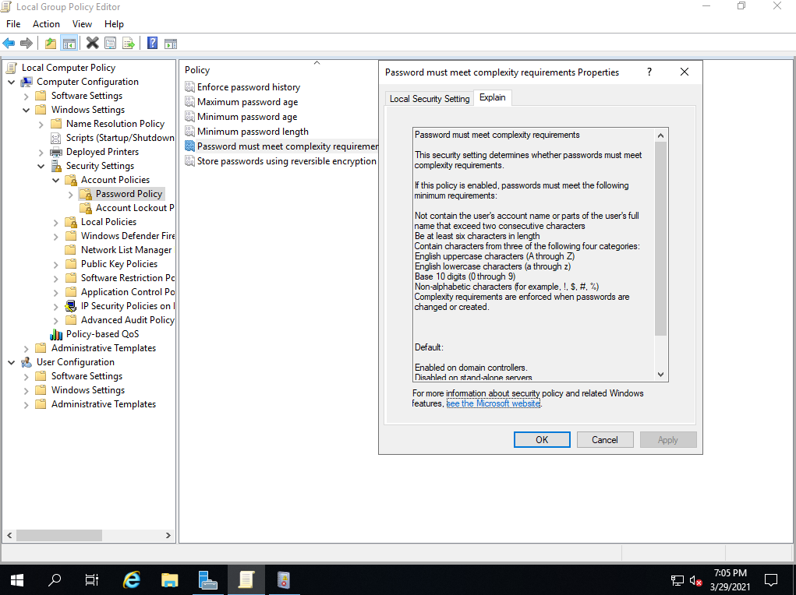
強制執行密碼歷程記錄

Slide 19
Password must meet complexity requirements
This security setting determines whether passwords must meet complexity requirements.
If this policy is enabled, passwords must meet the following minimum requirements:
Not contain the user's account name or parts of the user's full name that exceed two consecutive characters
Be at least six characters in length
Contain characters from three of the following four categories:
English uppercase characters (A through Z)
English lowercase characters (a through z)
Base 10 digits (0 through 9)
Non-alphabetic characters (for example, !, $, #, %)
Complexity requirements are enforced when passwords are changed or created.
Default:
Enabled on domain controllers.
Disabled on stand-alone servers.
Note: By default, member computers follow the configuration of their domain controllers.

Slide 20
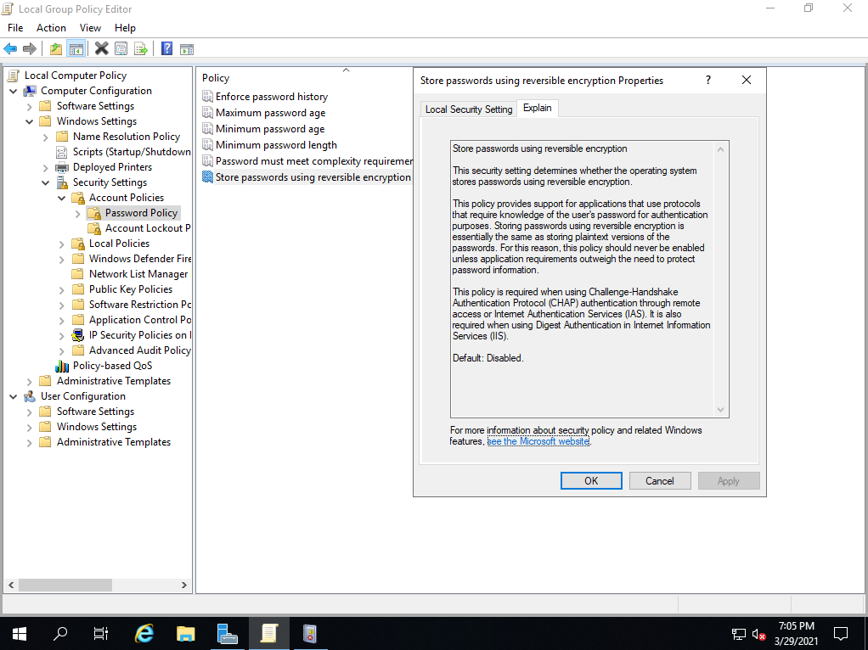
最小密碼長度

Slide 21
Store passwords using reversible encryption
This security setting determines whether the operating system stores passwords using reversible encryption.
This policy provides support for applications that use protocols that require knowledge of the user's password for authentication purposes. Storing passwords using reversible encryption is essentially the same as storing plaintext versions of the passwords. For this reason, this policy should never be enabled unless application requirements outweigh the need to protect password information.
This policy is required when using Challenge-Handshake Authentication Protocol (CHAP) authentication through remote access or Internet Authentication Services (IAS). It is also required when using Digest Authentication in Internet Information Services (IIS).
Default: Disabled.

Slide 22
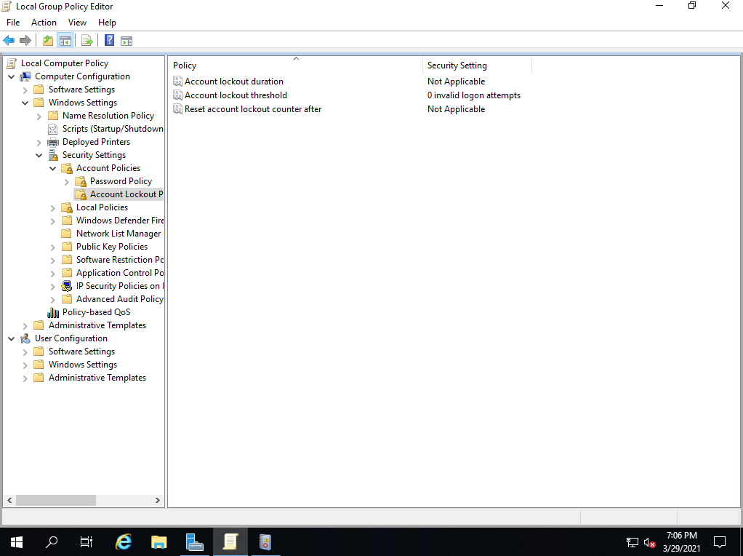
帳戶鎖定原則

Slide 23
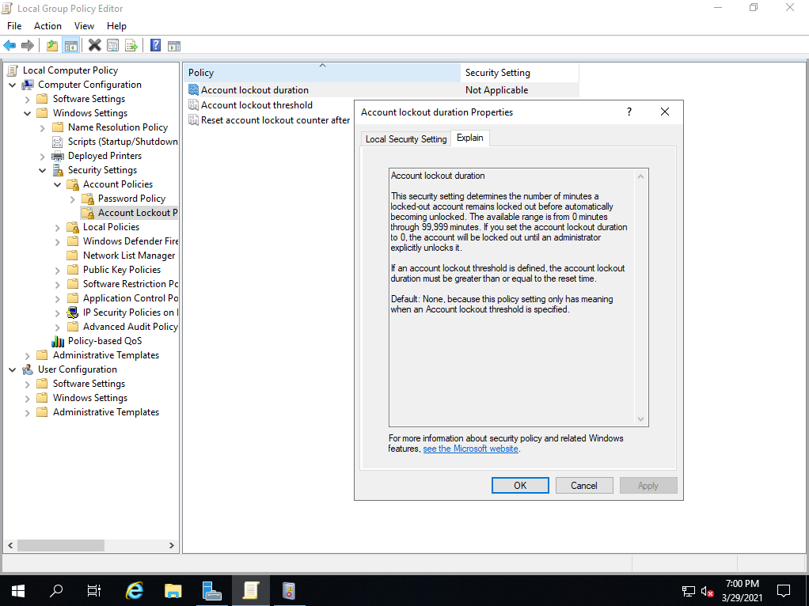
重設帳戶鎖定計數器

Slide 24
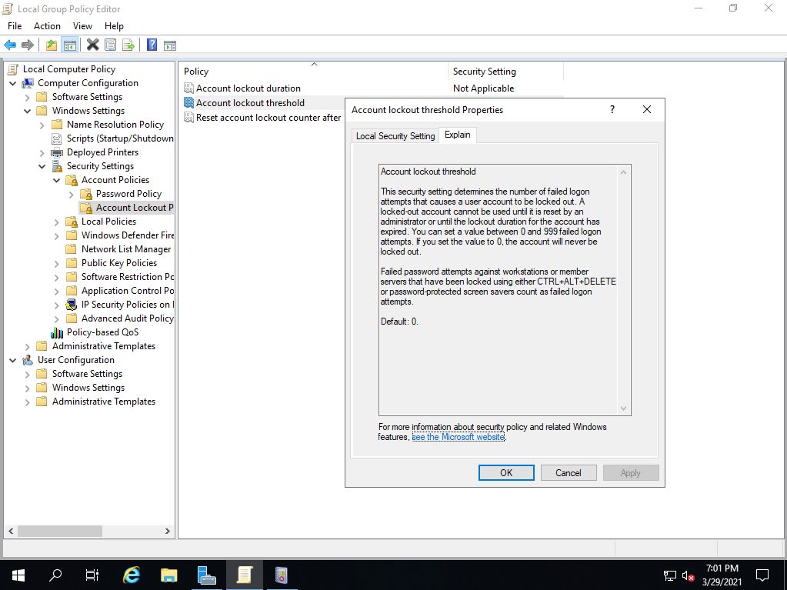
帳戶所定時間

Slide 25
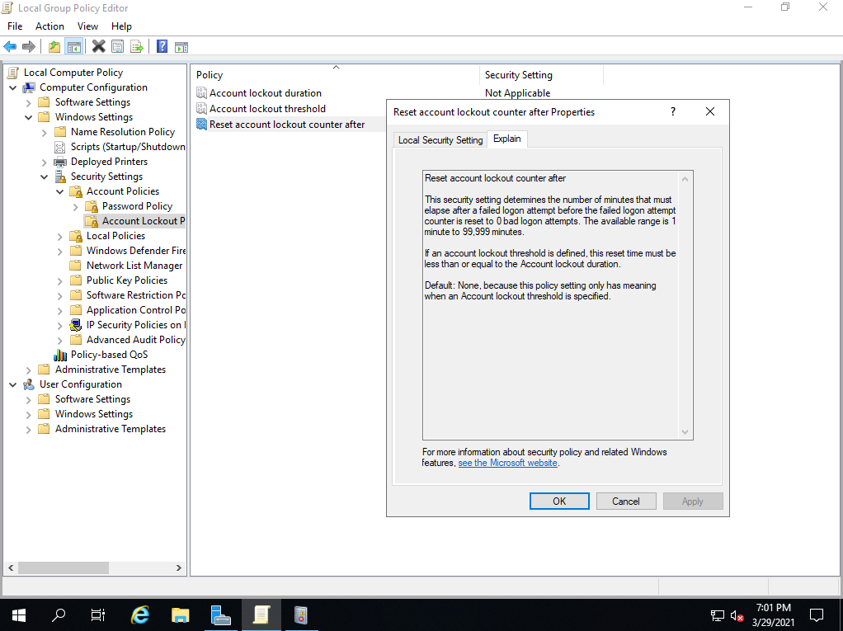
帳戶鎖定闢值

Slide 26
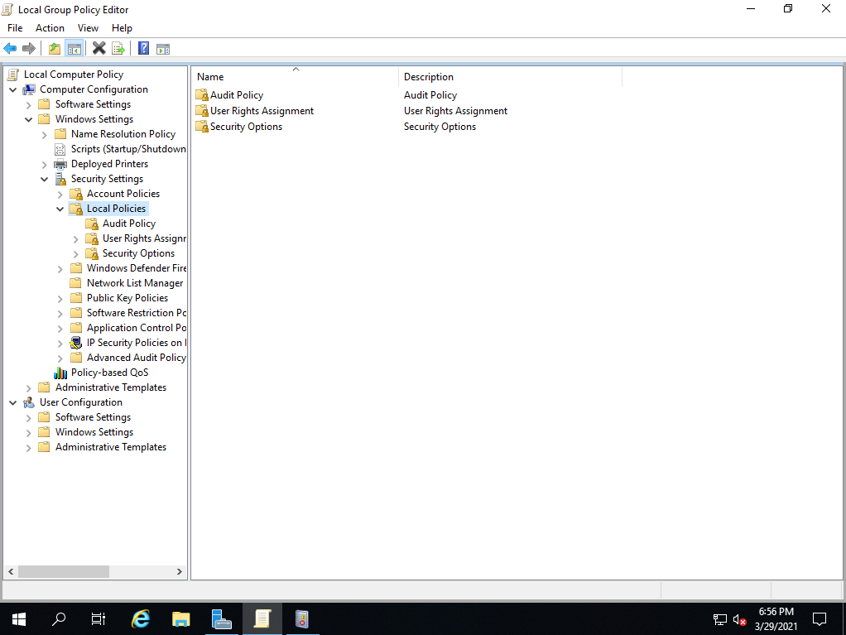
本機原則

Slide 27
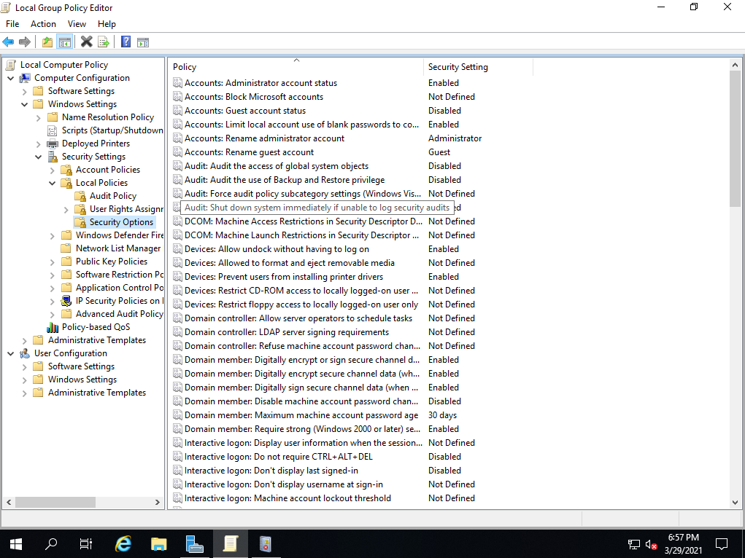
安全性選項

Slide 28
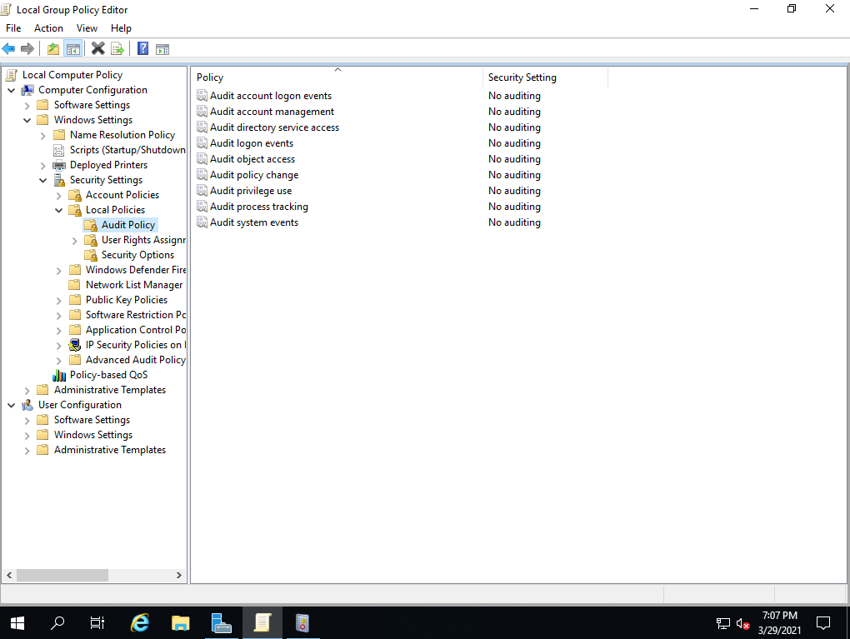
稽核原則(Local Policies)

Slide 29
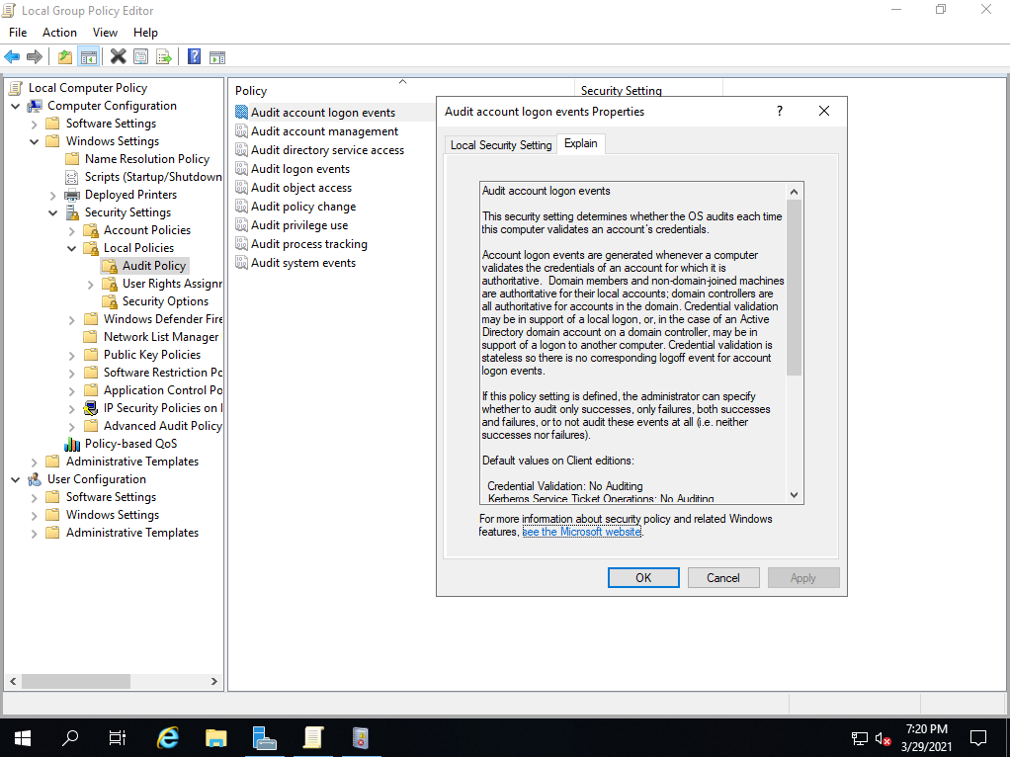
稽核目錄服務存取

Slide 30
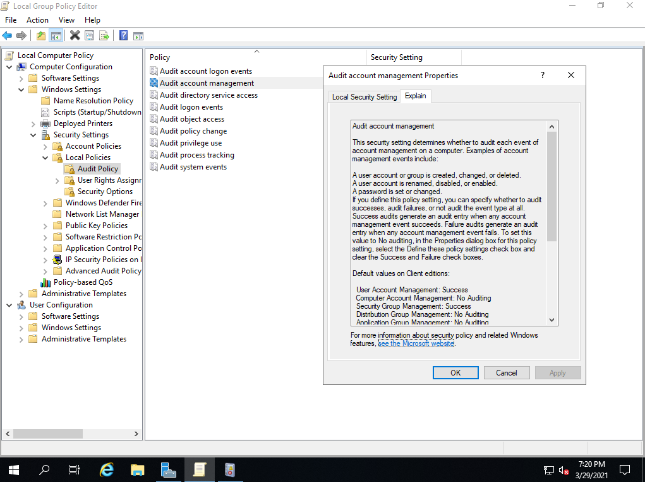
稽核系統事件

Slide 31
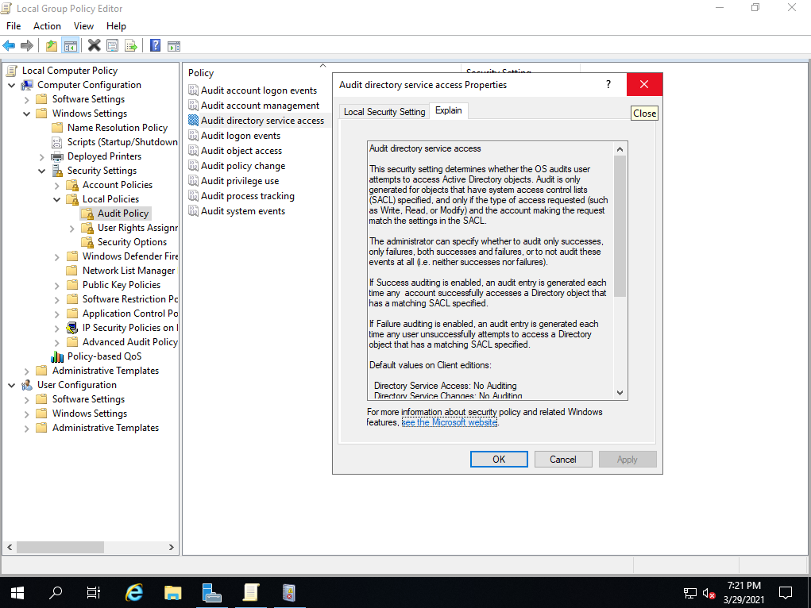
稽核物件存取

Slide 32
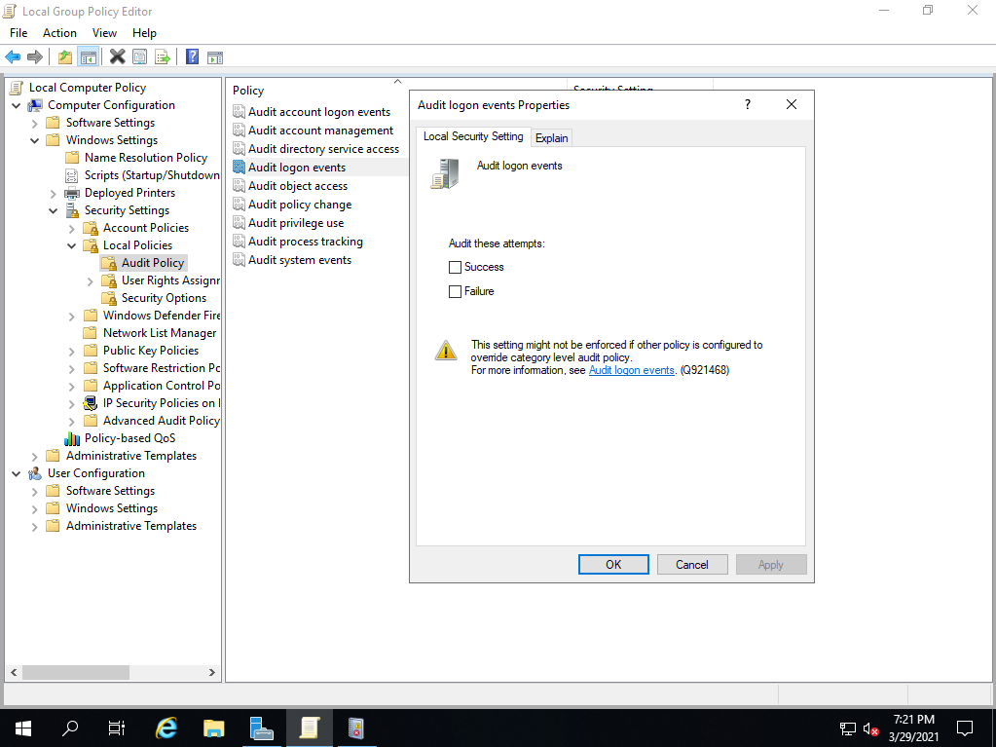
稽核原則變更

Slide 33
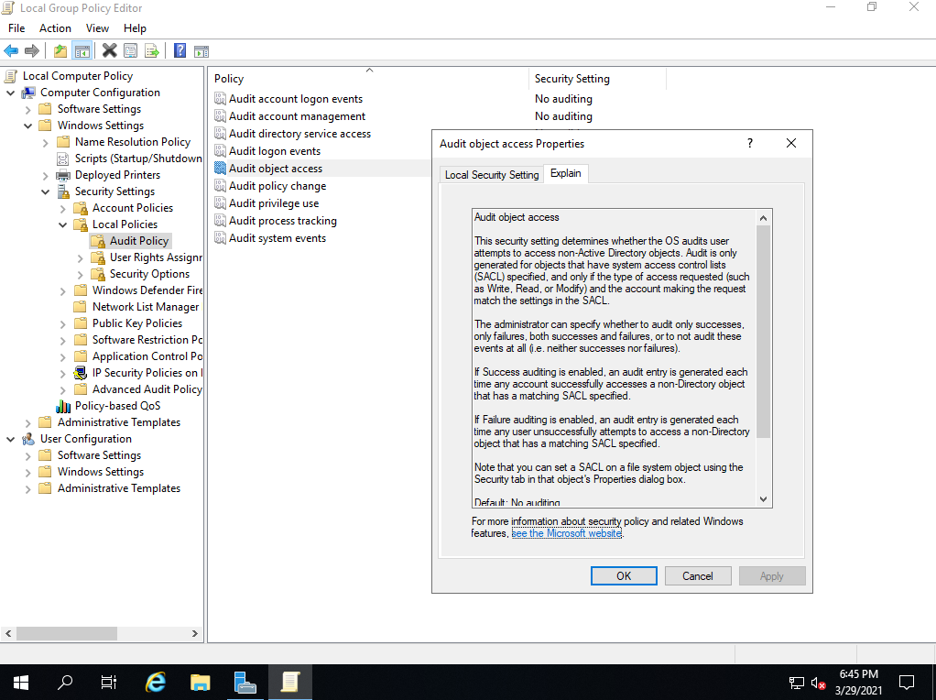
稽核特殊權限使用

Slide 34
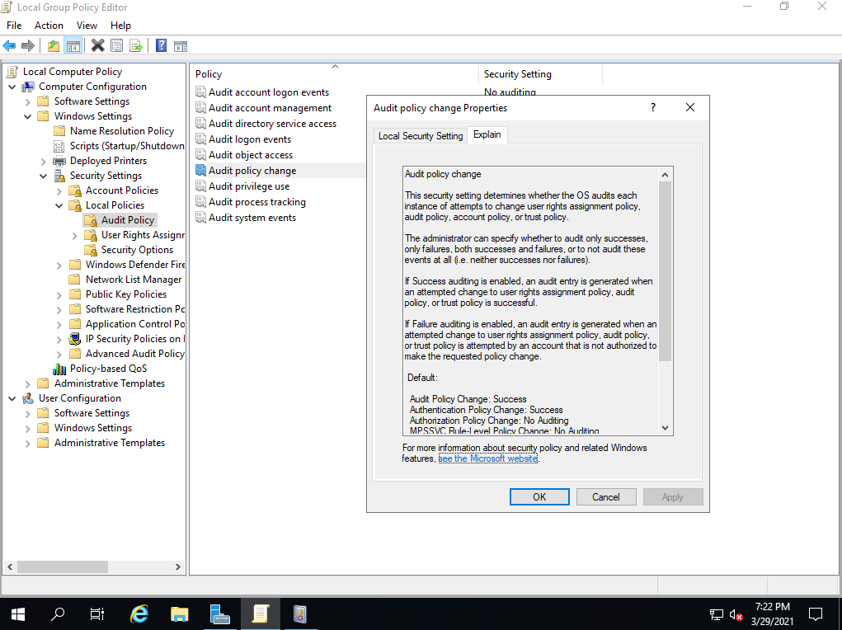
稽核帳戶登入事件

Slide 35
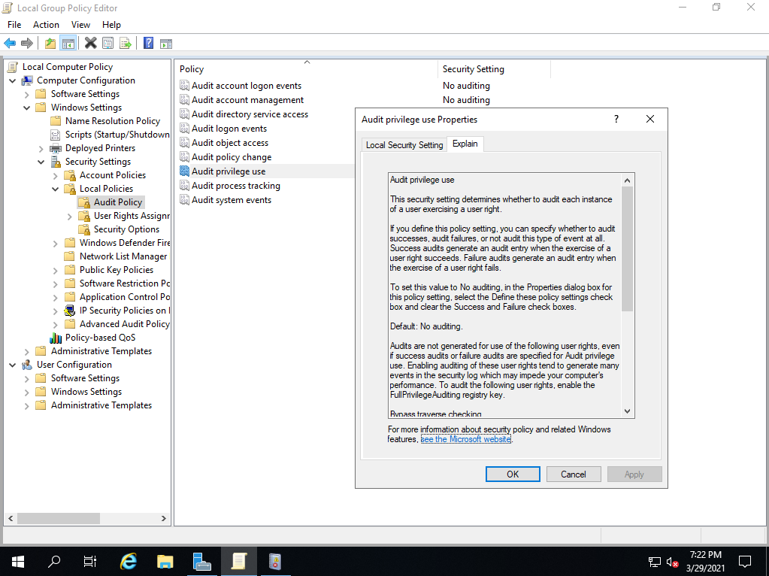
稽核帳戶管理

Slide 36
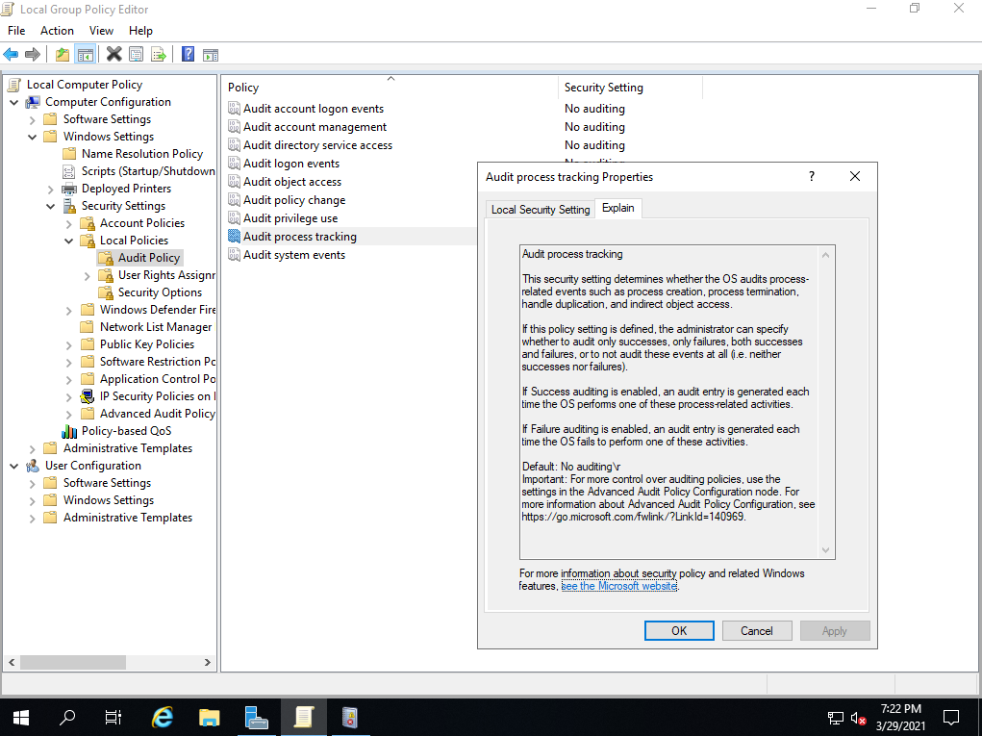
稽核登入事件

Slide 37
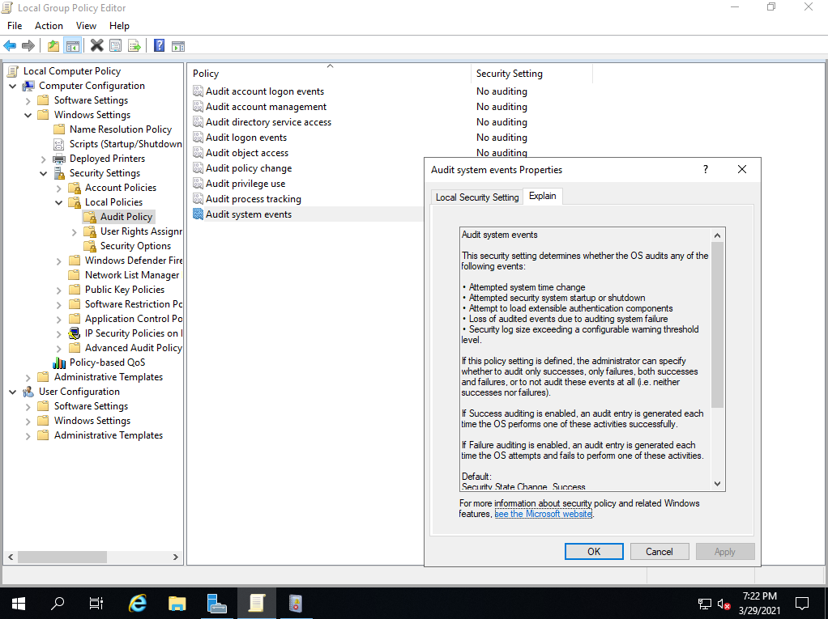
稽核程序追蹤

Slide 38
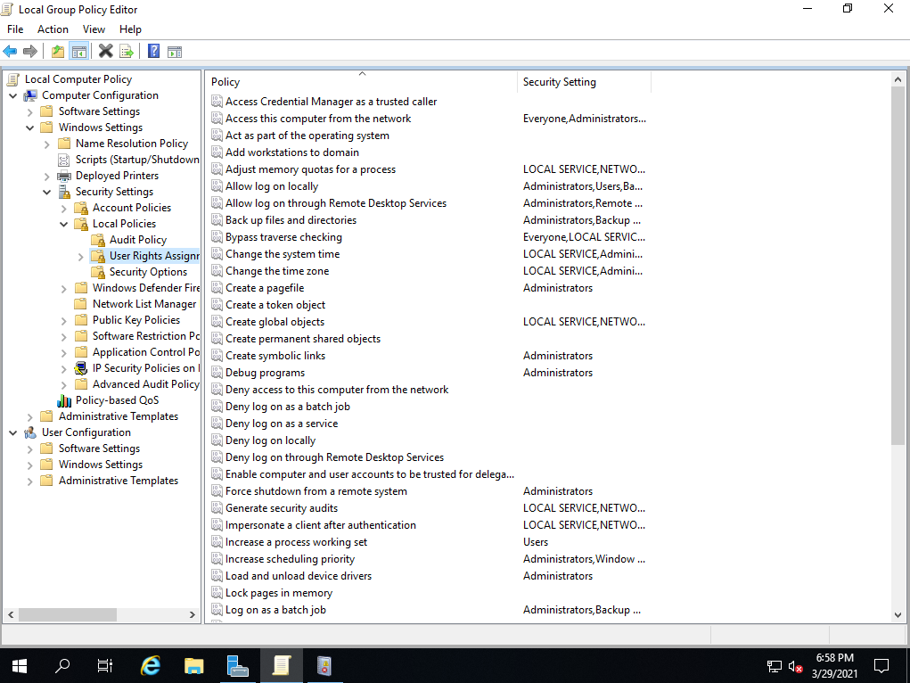
使用者權限指派

Slide 39
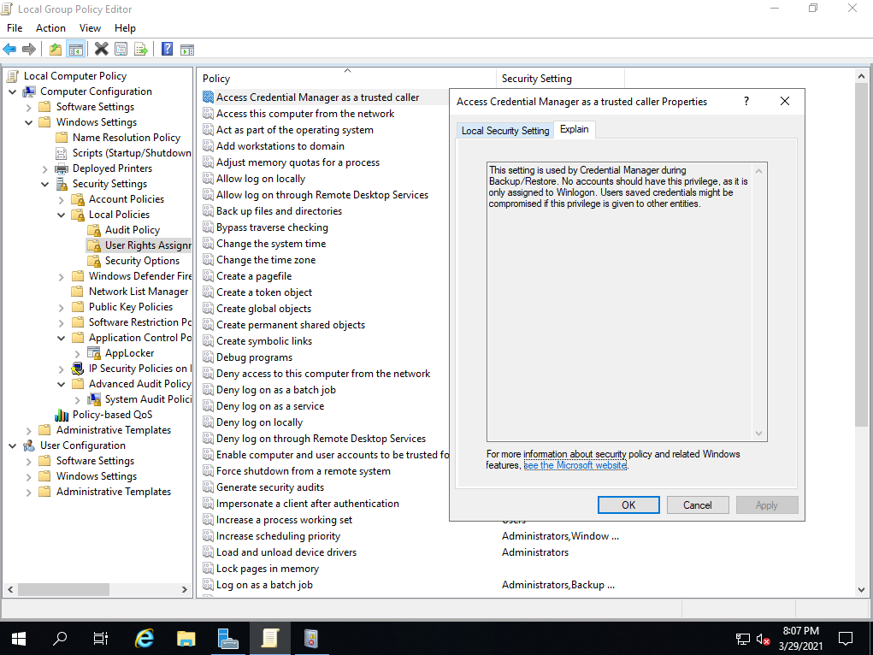
本機登入

Slide 40
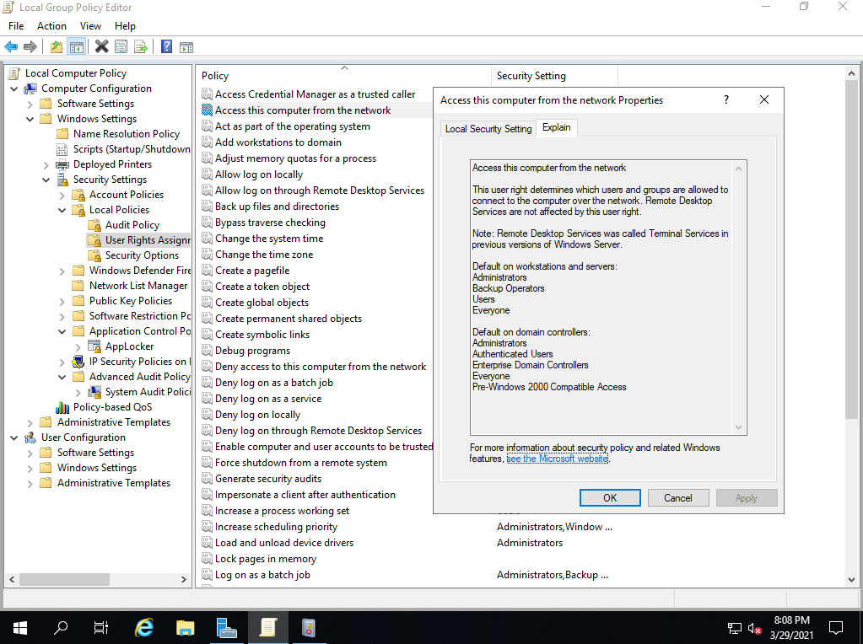
允許透過遠端桌面服務登入

Slide 41
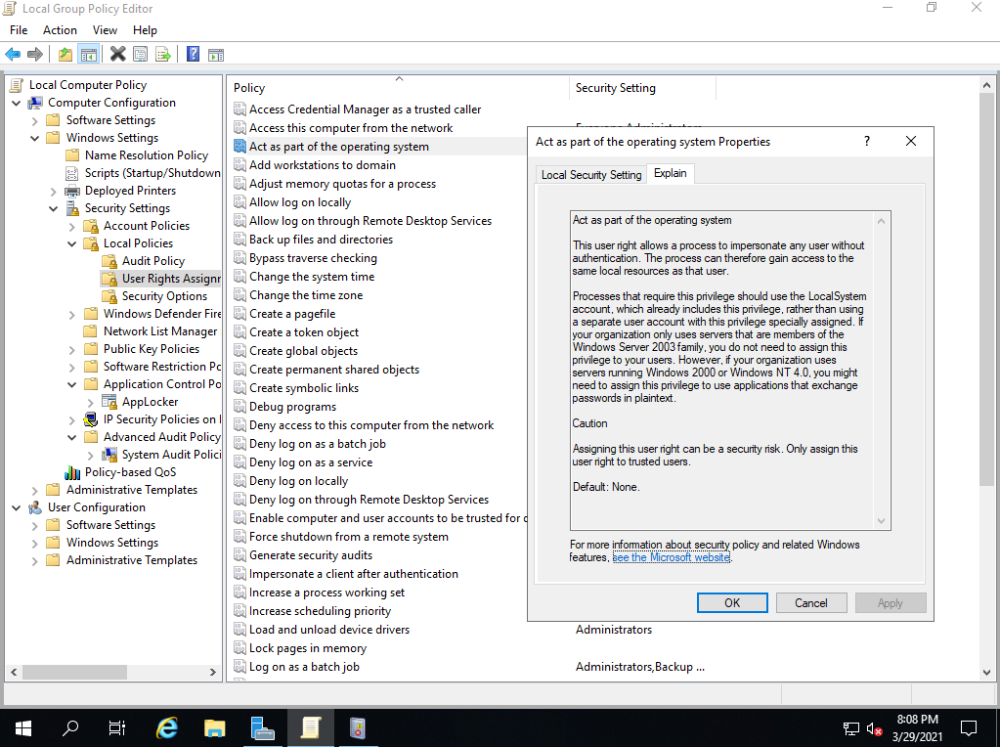
以批次工作登入

Slide 42
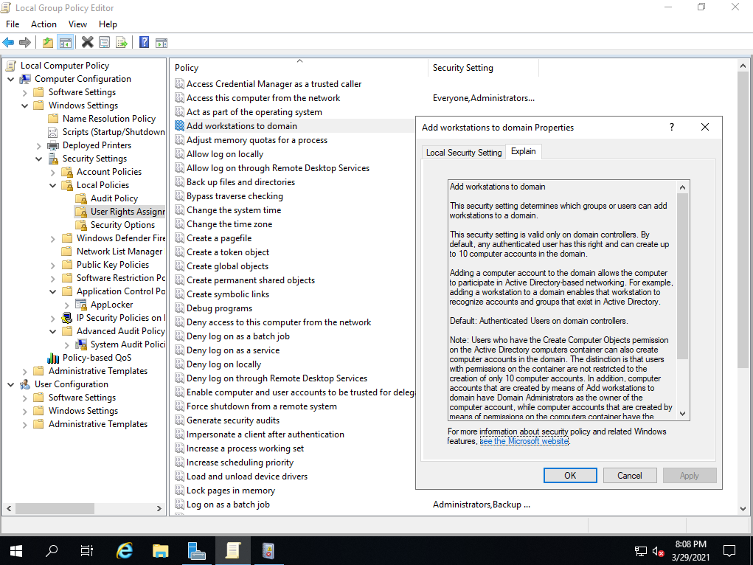
以服務方式登入

Slide 43
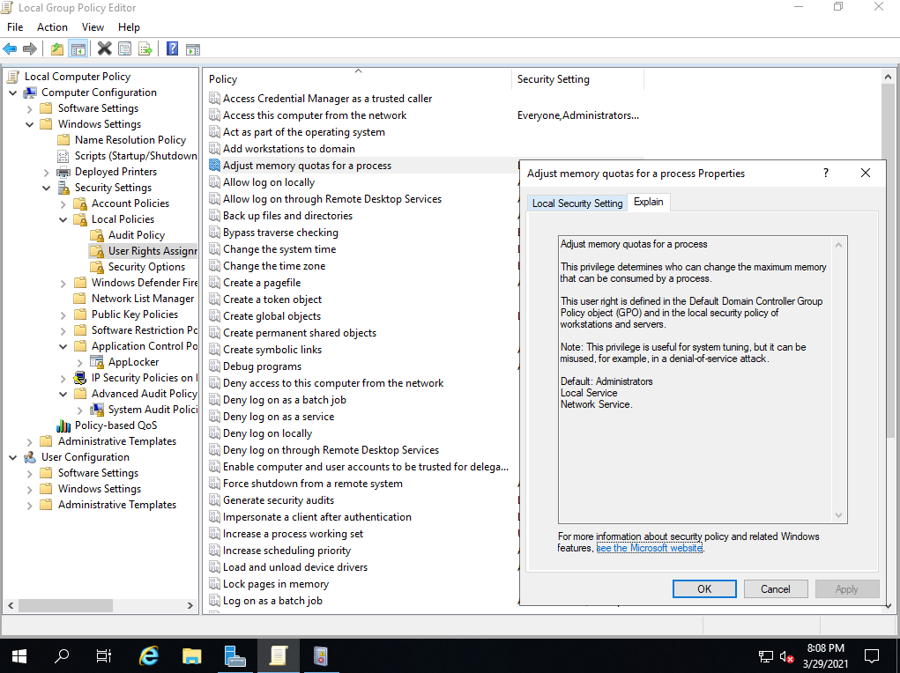
同步處理目錄服務資料

Slide 44
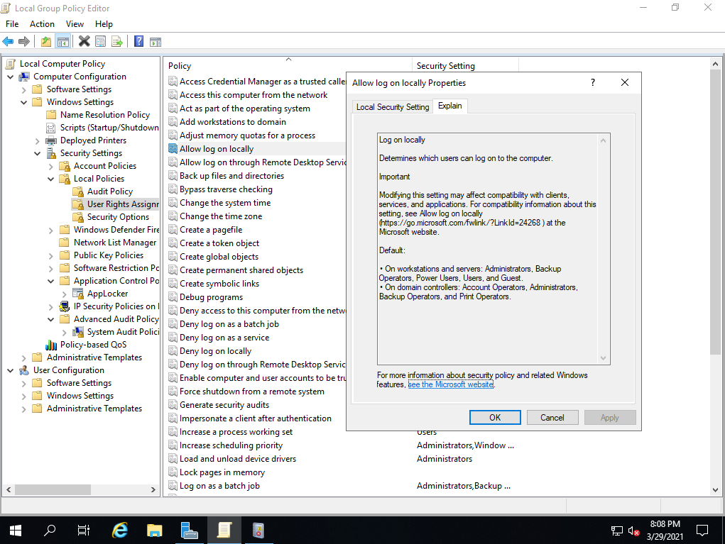
在驗證後模擬用戶端

Slide 45
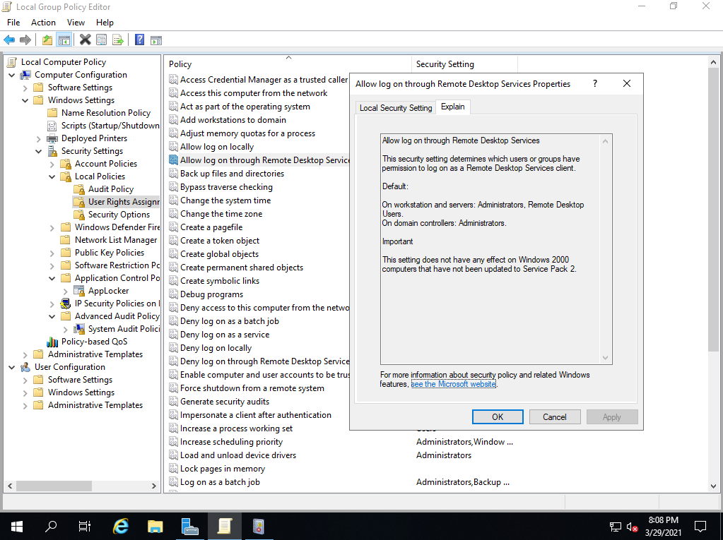
存取認證管理員作為信任的呼叫者

Slide 46
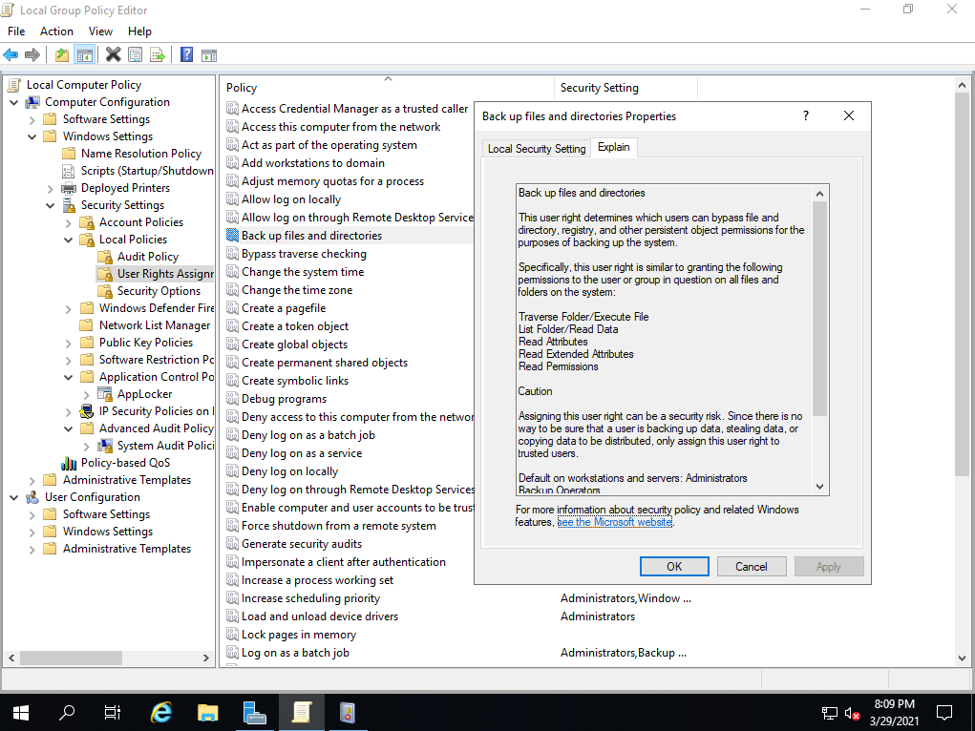
取代處理程序等級權杖

Slide 47
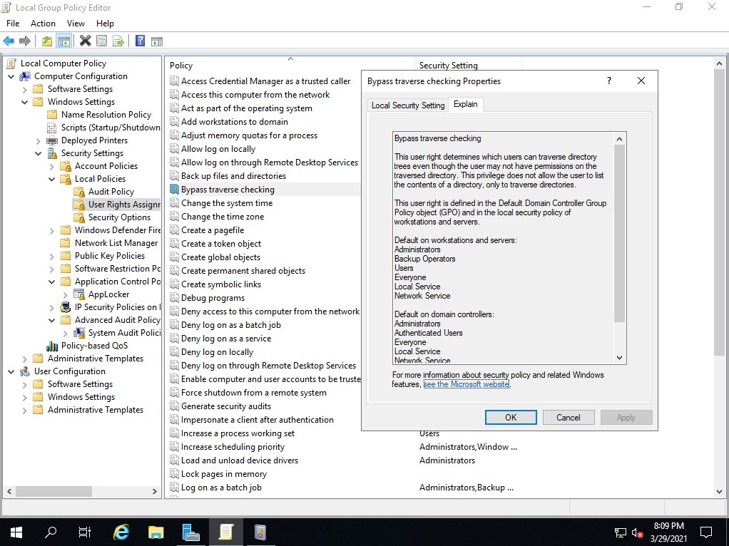
取得檔案或其他物件的擁有權

Slide 48
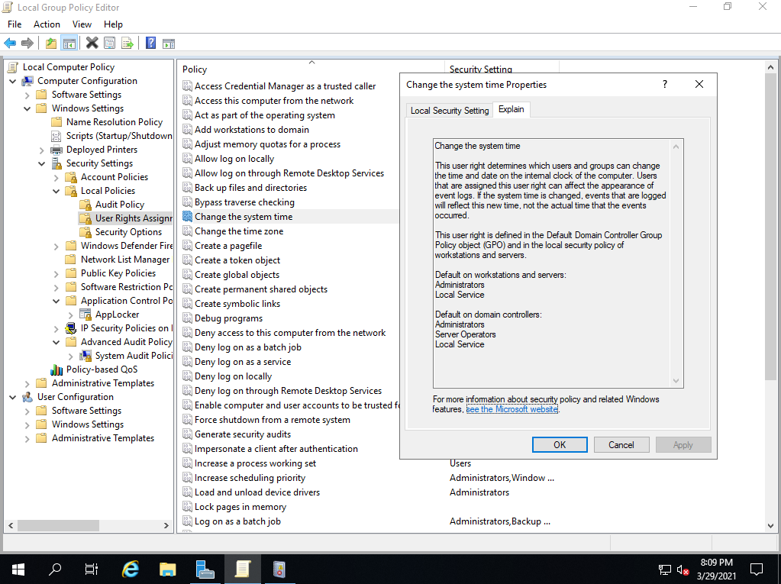
拒絕以批次工作登入

Slide 49
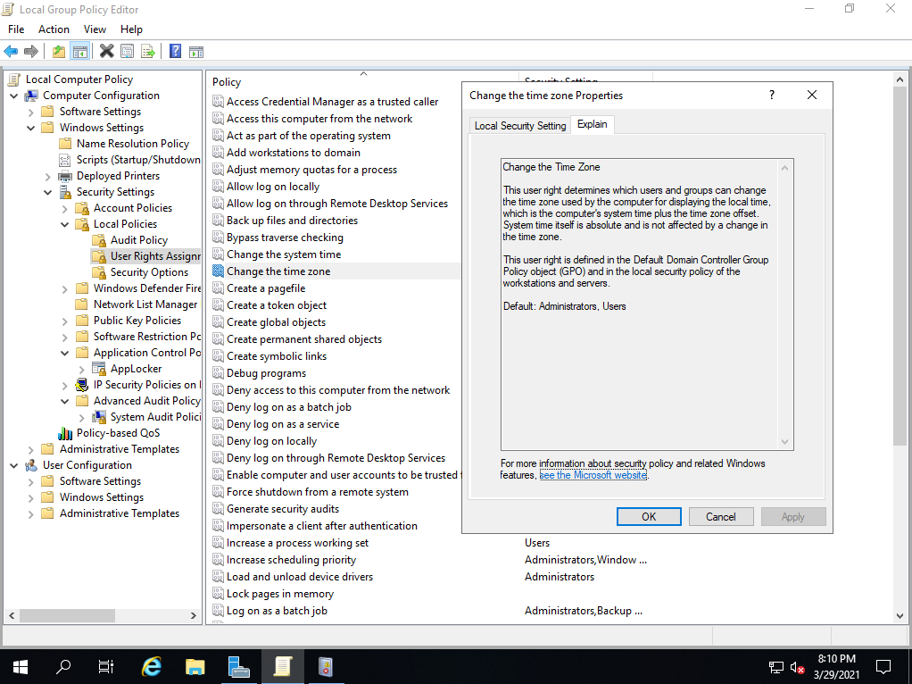
拒絕以服務方式登入

Slide 50
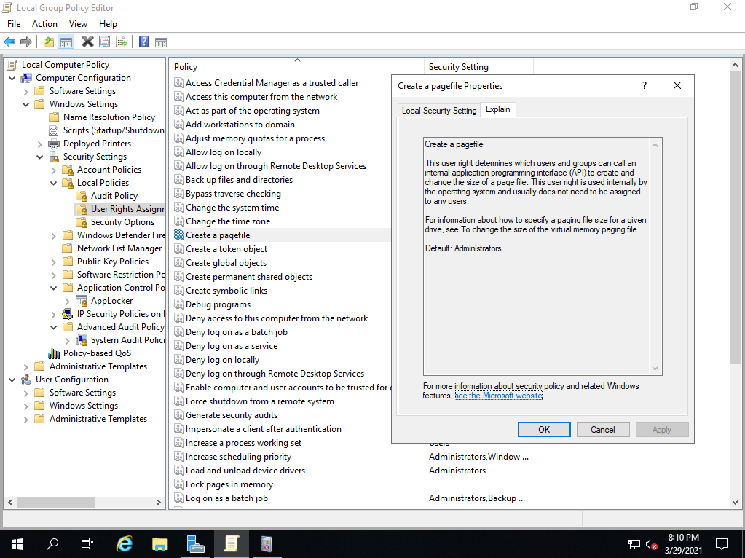
拒絕本機登入

Slide 51
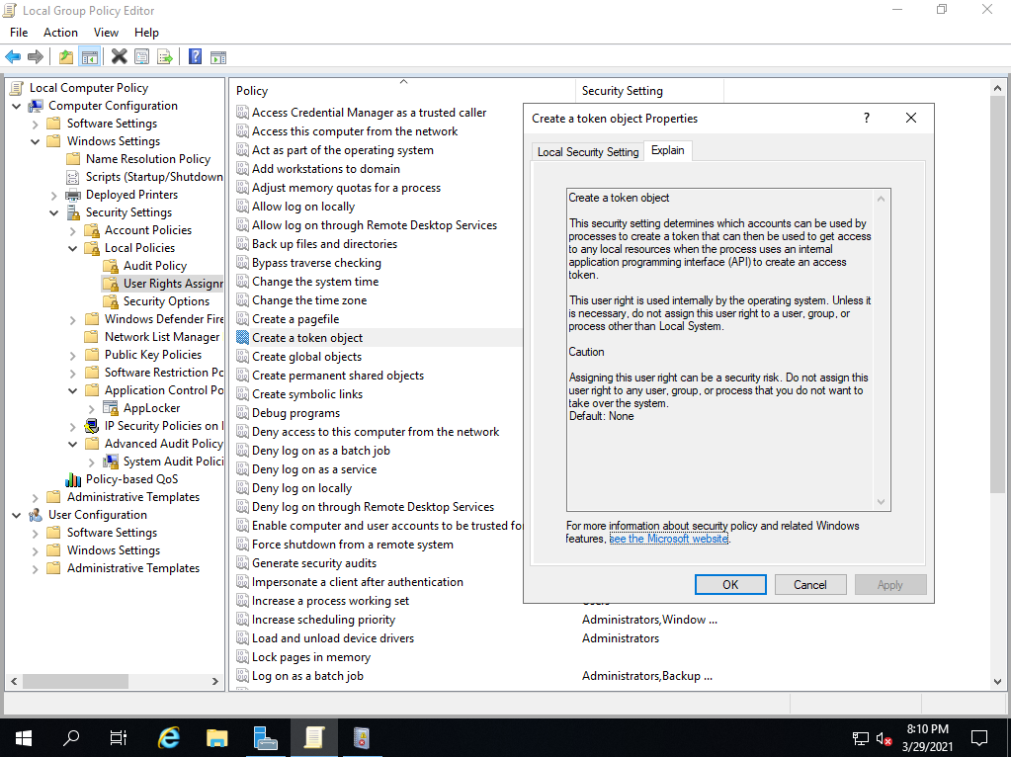
拒絕從網路存取這台電腦

Slide 52
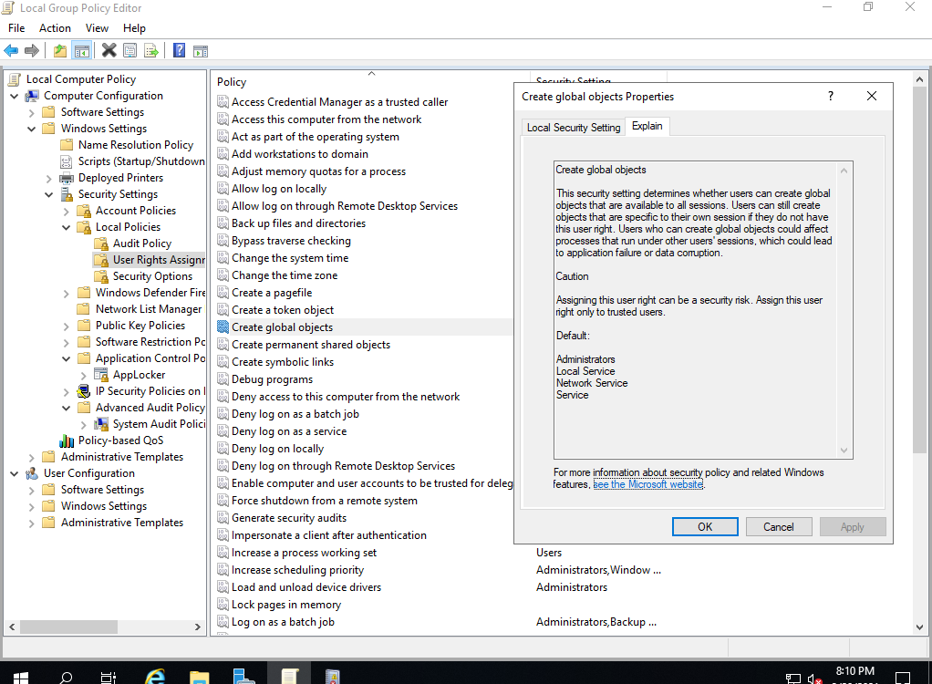
拒絕透過遠端桌面服務登入

Slide 53
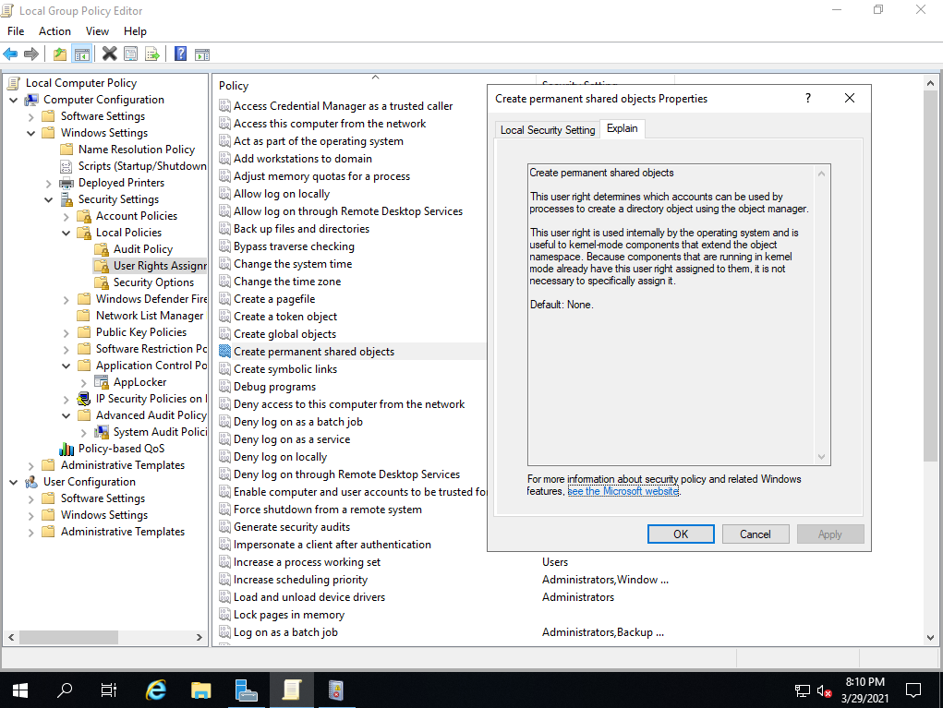
建立分頁檔

Slide 54
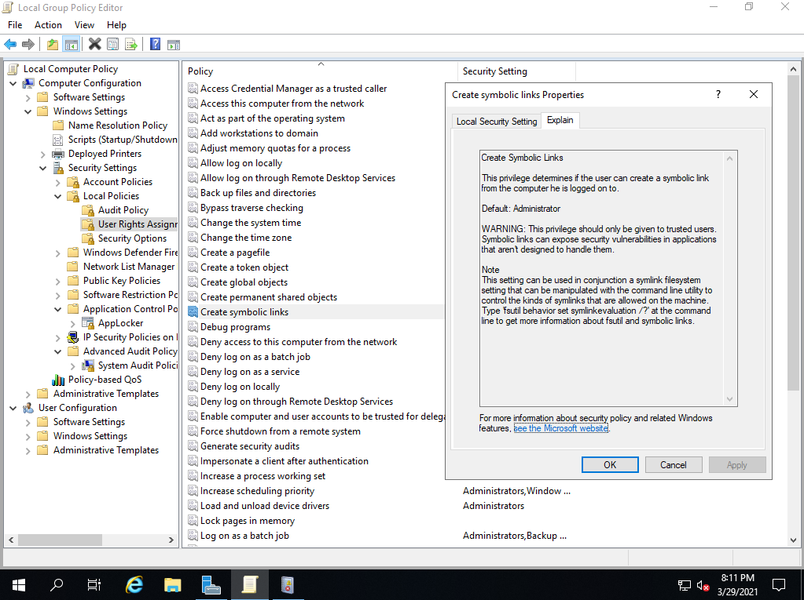
建立永久共用物件

Slide 55
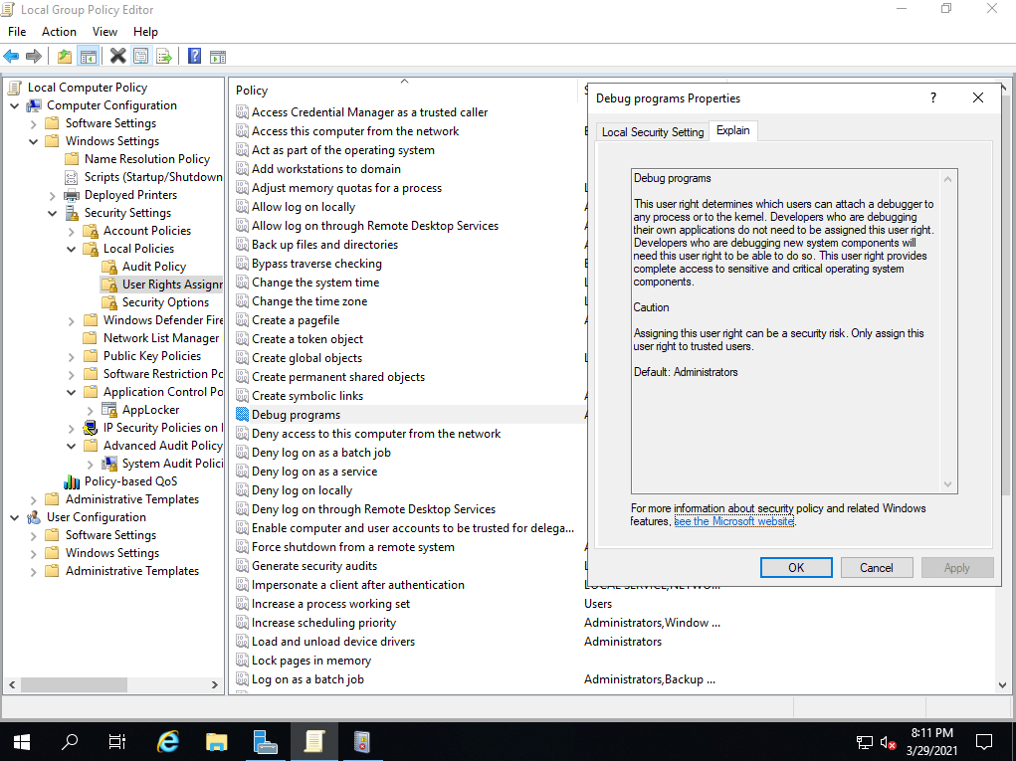
建立符號連結

Slide 56
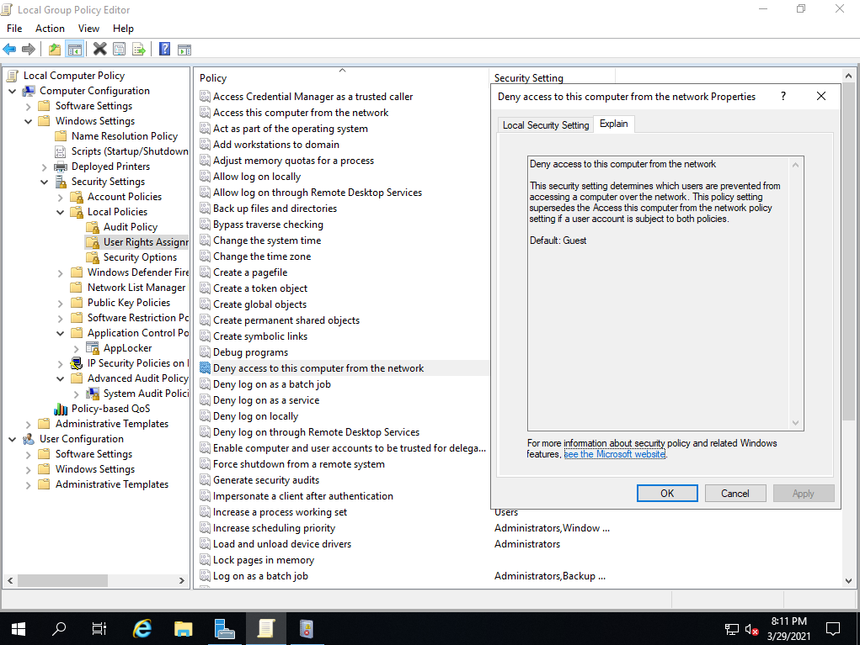
建立全域物件

Slide 57
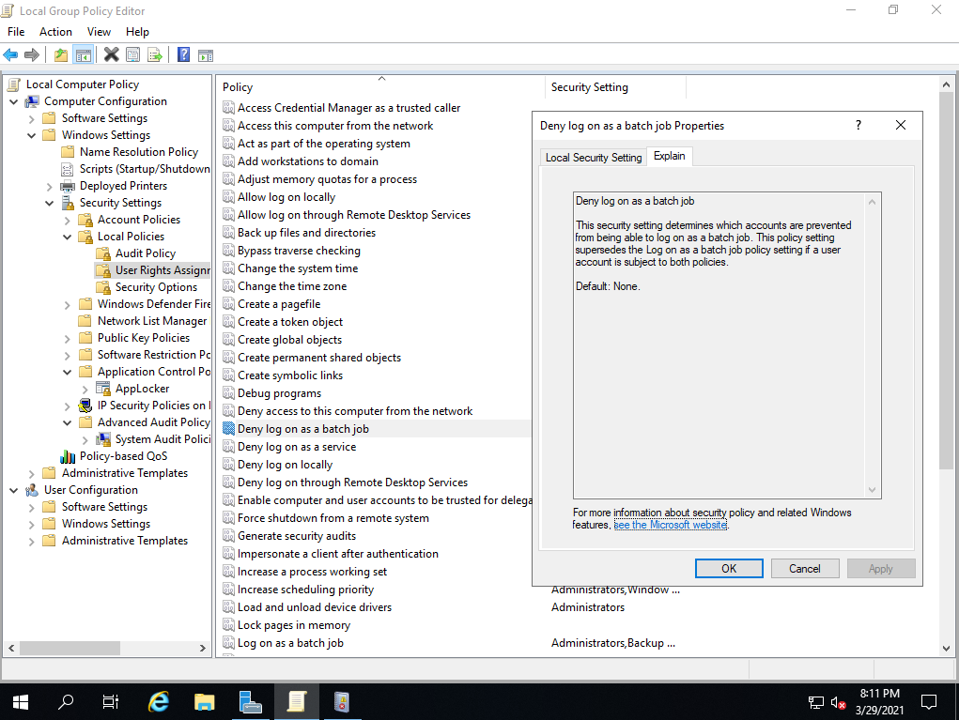
建立權杖物件

Slide 58

為相同工作階段中的另一個使用者取得模擬權杖

Slide 59

修改物件標籤

Slide 60

修改韌體環境值

Slide 61

偵錯程式

Slide 62

執行磁碟區維護工作

Slide 63

將工作站新增至網域

Slide 64

強制從遠端系統進行關閉

Slide 65

從網路存取這台電腦

Slide 66

從擴充座移除電腦

Slide 67

產生安全性稽核

Slide 68

略過周遊檢查

Slide 69

備份檔案及目錄

Slide 70

當成作業系統的一部分

Slide 71

載入及解除載入裝置驅動程式

Slide 72

監視系統效能

Slide 73

監視單一處理程序

Slide 74

管理稽核及安全性記錄檔

Slide 75

增加排程優先順序

Slide 76

增加處理程序工作組

Slide 77

調整處理程序的記憶體配額

Slide 78

還原檔案及目錄

Slide 79

鎖定記憶體中的分頁

Slide 80

關閉系統

Slide 81

變更系統時間

Slide 82

變更時區

Slide 83

讓電腦及使用者帳戶受信賴，以進行委派

Slide 84

進階安全性的Windows Defender防火牆

Slide 85

防火牆新增規則

Slide 86

網路清單管理原則

Slide 87

Event Viewer(檢視觸發事件)

Slide 88

安全性選項

Slide 89

DCOM: 以 Security Descriptor Definition Language (SDDL) 語法表示的電腦存取限制

Slide 90

應用程式控制原則

Slide 91

系統稽核原則-本機群組原則物件

Slide 92

印表機設定

Slide 93



